Slide 1
Minor Project Review – II
Project Title : Password Manager using AI Authentication.
Batch – A3 :
19K41A0513 - K.Rishinandan
19K41A0517 - Mohammed Raamizuddin
19K41A0560 - V.Sai Likhitha
Project Guide
Dr. T Sampath Kumar

Slide 2
Project Domain :
Password Management for various websites and applications for a user.
Objective :
The objective of this Application is to Store and retrieve passwords for different accounts over the internet or various applications using an advanced AI based authentication system which authenticates the user on his/her behaviour.

Slide 3
Existing System :
Users remember all the passwords for different accounts they hold.
The users should manually maintain a list of all usernames and passwords.
Existing password managing applications have a complex user interface.

Slide 4
Existing System : (Drawbacks)
The users saves the passwords in some text format which is risky since it can be exploited.
The password managers embedded in the web-browsers are not reliable since there is a chance of exposure of this sensitive information.

Slide 5
Proposed System :
Our Password Manager Application has a graphical user interface developed using Java.
It basically stores the username and password details in an encrypted format in the database. The encryption is managed by a symmetric key encryption algorithm.

Slide 6
Methodology :
It checks for the validity of the user using a master username and password which will be verified by a neural network for that user’s specific behaviour.
Once the user is logged in, he/she shall be able to manage the passwords that is stored by them into the encrypted database.
The Passwords are always encrypted so that there is no risk of exposure to unauthenticated persons.

Slide 7
Modules :
User Authentication Module: This module will have the fields to authenticate the user. It has the username and password fields.
User Accounts-passwords Module: This module will have the details regarding the different accounts held by the user over the internet and various applications (i.e. their passwords and usernames).

Slide 8
Technologies :
Java.
Neural Network Algorithm for authentication.
MySQL Database.
Terminology :
Security.
Encryption.
Behavioral Authentication.

Slide 9
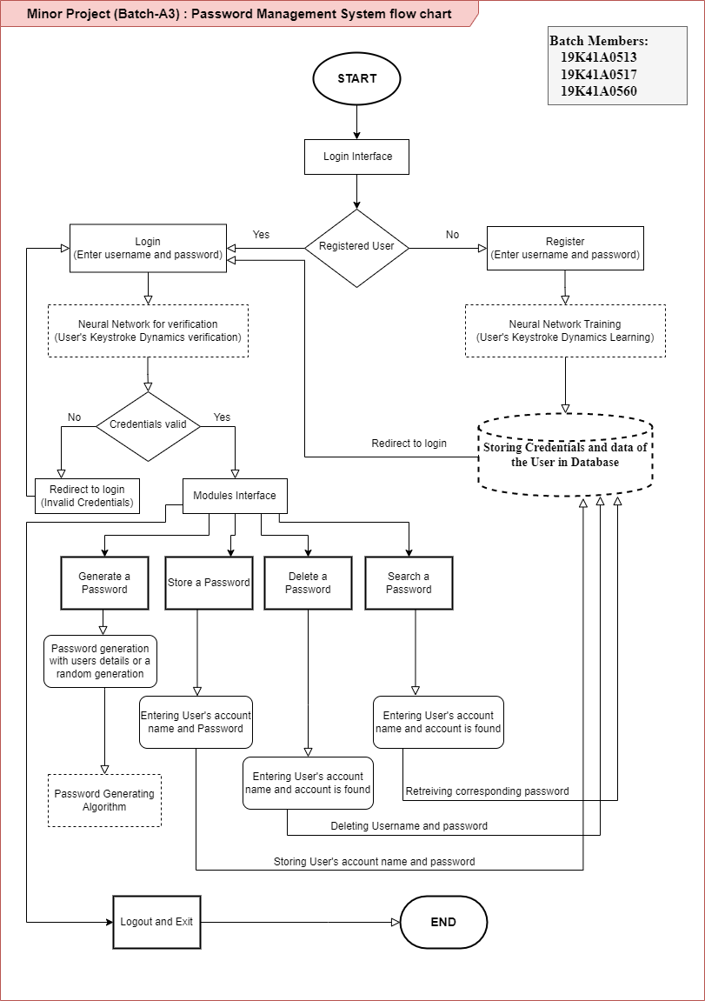
Flowchart of the
system :

Slide 10
Thank you

